Slide 1
Division of Transfusion Medicine
Platelet Transfusion Management using R and the Tidyverse
Web-based Clinical Decision Support
Justin Juskewitch MD, PhD; Andrew Norgan MD, PhD
rstudio::conf
January 30, 2020

Slide 2
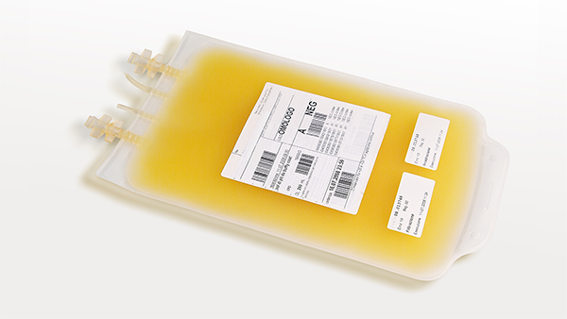
Platelets: A Limited and Expensive Resource
Central role in blood clotting
Trauma and oncology patients
1-2 hours of donor’s time
Good for 5 days after collection
Only 1-2 day supply across nation
Picture courtesy of CDC

Slide 3
Right Product for the Right Patient
Some patients have platelet antibodies (HLA)
- Caused by pregnancy or past transfusion
- Cause platelet destruction immediately
Donors have 4 “flavors” of platelet HLA molecules
Avoidance of HLA antibodies
- Reduce number of platelet transfusions
- Stop and prevent patient bleeding
- Decrease medical costs
A2
A2
B7
B35
A1
A2
B8
B44
A3
A68
B13
B44
A3
A24
B7
B51
A1
A32
B27
B62

Slide 4
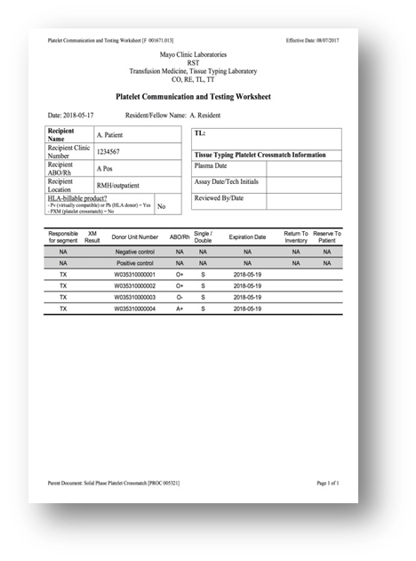




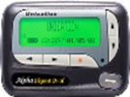
Data Sources
Reservation Form
TM LIS
TM Trainee
ABO/Rh
HLA Typing (4)
Unit Information
Donor Information
EHR
Recipient Name
Recipient MRN
Recipient Location
Recipient ABO/Rh
Unit Information
Donor Information
What is compatible?
What is most similar?
What is expiring?
ABO/Rh
HLA Antibody (~50)
HLA Typing (4)
Computers are good at this kind of thing…
How to do it with only limited application programming experience?

Slide 5


Challenge #1: Need an Application
Requirements:
Web-based
Data analytics
Interactive
Open source (free)
Ample training materials
No formal computer programming training (limited Python and R experience)
Solution: Shiny framework
Notes:
https://shiny.rstudio.com/

Slide 6
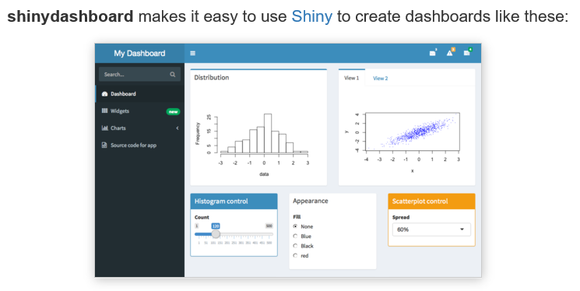
Challenge #2: Need a User Interface
Requirements:
Shiny compatible
Ample training materials
Graphical
Intuitive
Guide user input
Default proof
Solution: shinydashboard
Notes:
https://rstudio.github.io/shinydashboard

Slide 7
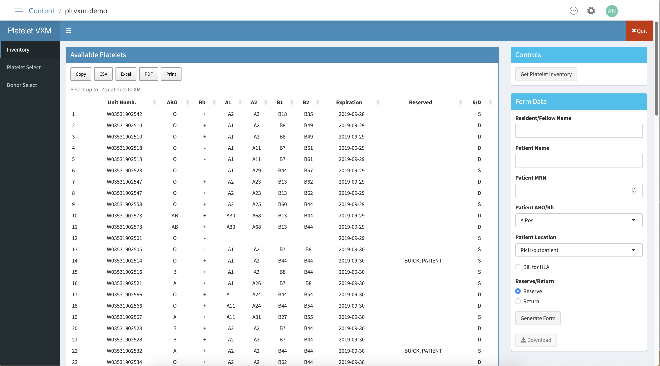

Slide 8
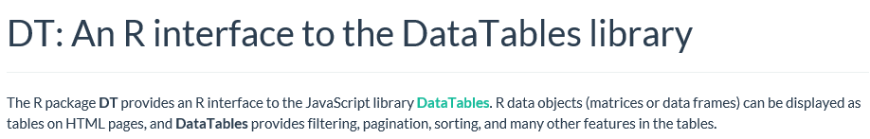
Challenge #3: View and Manipulate Data Tables
Requirements:
Display data tables in shinydashboard
Remove rows (incompatible inventory / donors)
Create columns (platelet match degree formulas)
Sort data (expiration date, platelet match degree)
Solution: DT package
Notes:
https://rstudio.github.io/DT/

Slide 9
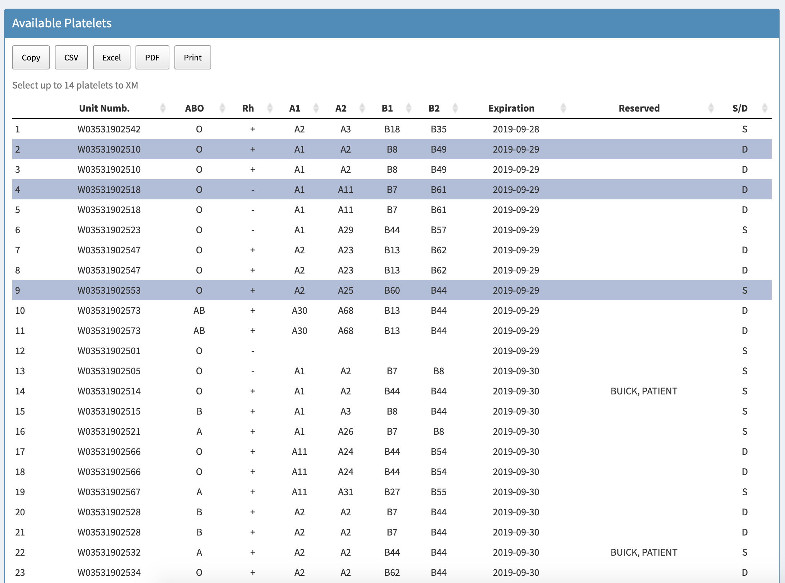

Slide 10

Challenge #4: Retrieve Platelet / Recipient Data in Real-Time
Requirements:
Dynamic data (real-time retrieval)
Draw platelet inventory or donor data from Tableau API
Draw patient data from DART API (institutional R package)
Solution: httr package
Notes:
https://cran.r-project.org/web/packages/httr/vignettes/quickstart.html

Slide 11
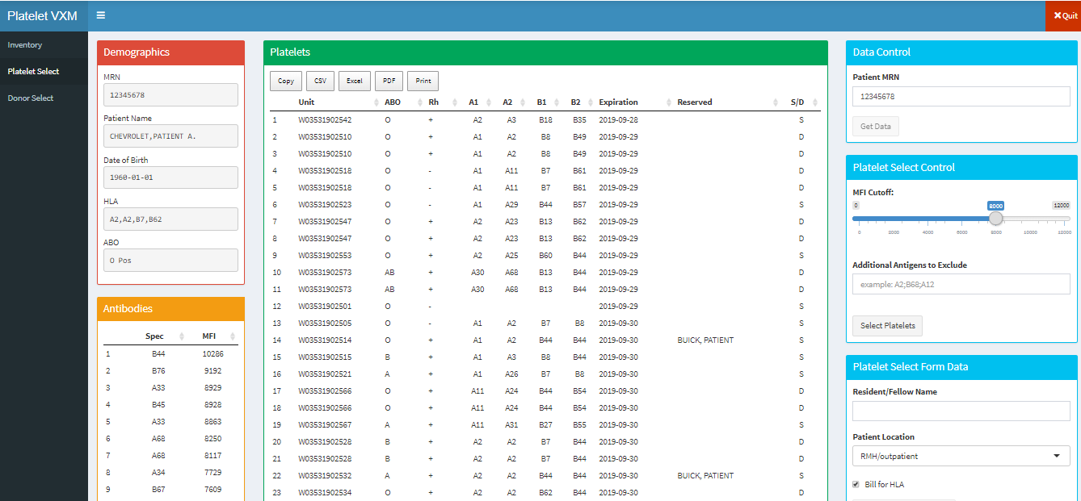
Notes:
https://hsr-rsc-dev.mayo.edu:1919/connect/#/apps/122/access

Slide 12
Challenge #5: Long Data Query Times
Requirements:
Shorten query time (multiple data queries)
Cannot change query source or path (multiple systems along way)
Solution: future package
Run required data queries in parallel (asynchronous)
Overall query time = longest single query time
Notes:
https://rstudio.github.io/promises/articles/futures.html

Slide 13

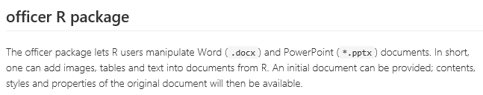
Challenge #6: Populate Controlled Documentation
Requirements:
Required controlled documentation forms
Populate with patient/inventory/donor data
Solution: officer package (Word document templates)
flextable package (Generate exact Word table formats)
Notes:
https://www.rdocumentation.org/packages/officer/versions/0.3.6

Slide 14
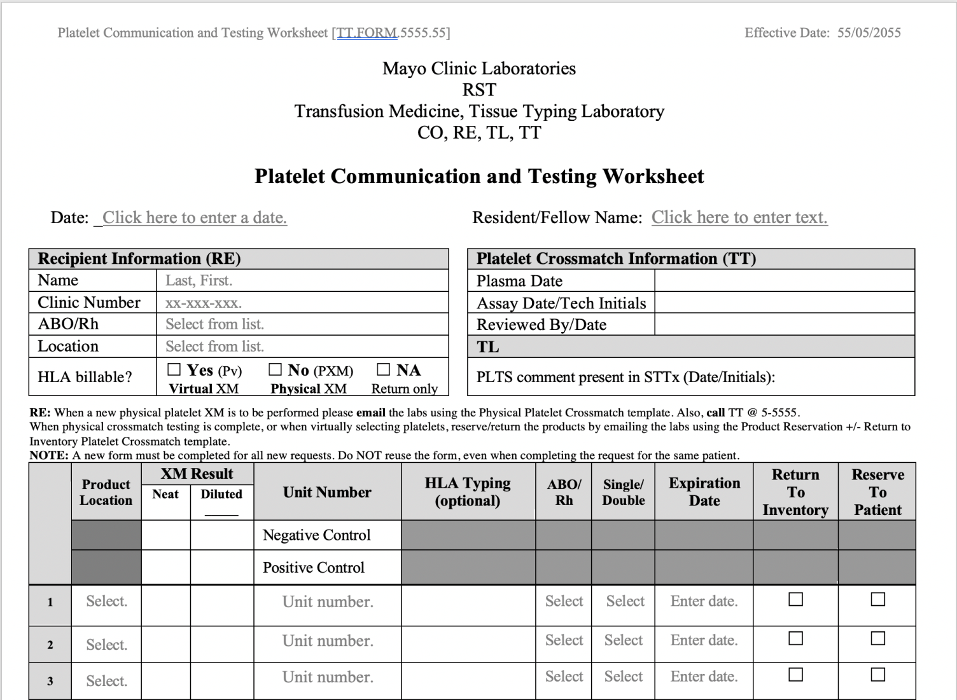
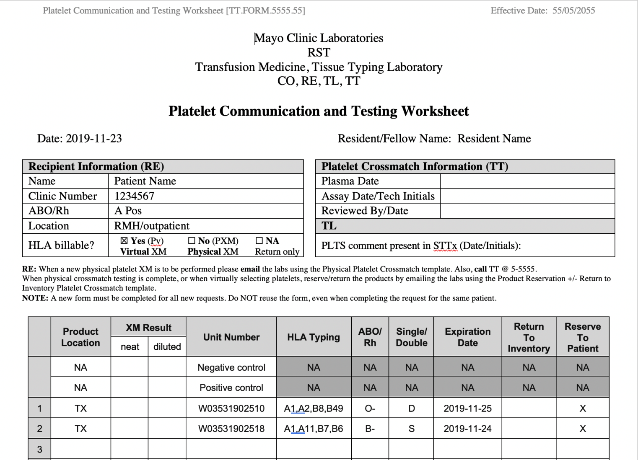
Head-to-Head Comparison
Controlled Document
Application Output

Slide 15
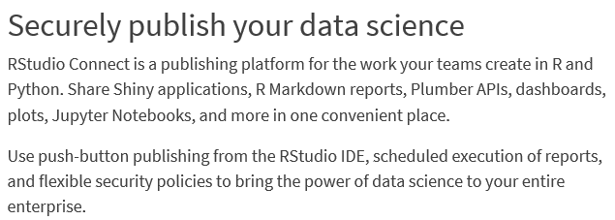
Challenge #7: Deploy New Application for Use
Requirements:
Institutional LDAP access control
Available across enterprise
One click deployment
Solution: RStudio connect server
Notes:
https://rstudio.com/products/connect/
Lightweight Directory Access Protocol

Slide 16
Median Task Completion Time

Slide 17
Maximum Number of Incompatible Units/Donors Presented

Slide 18
Maximum Number of Reservation Form Errors

Slide 19








R: Amazing Community and Flexibility
Software packages to solve each problem
Flexibility to build an API interface when needed
Deployment tools made application easily available and secure for users
Futures
httr
Many
Others

Slide 20
Division of Transfusion Medicine
THANK YOU
QUESTIONS AND DISCUSSION
Justin Juskewitch MD, PhD; Andrew Norgan MD, PhD
juskewitch.justin@mayo.edu; norgan.andrew@mayo.edu

